Slide 1

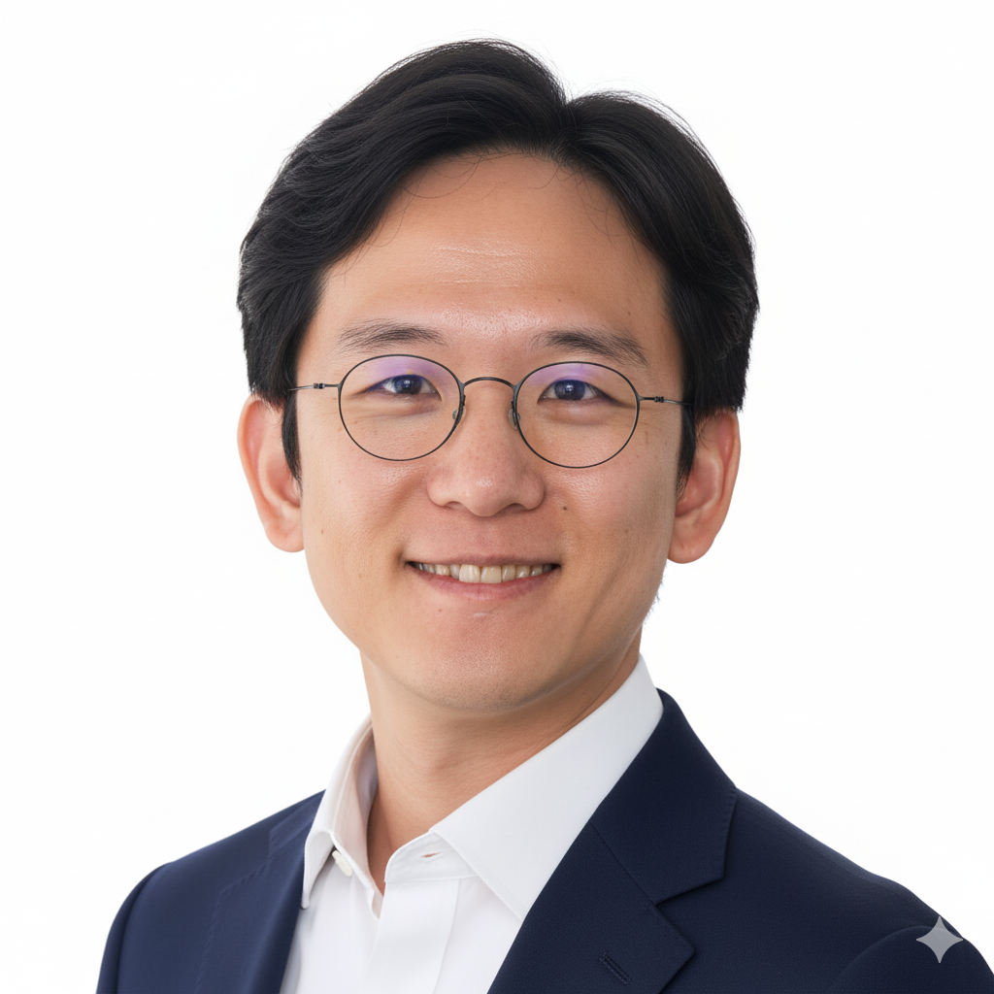


Jae-Won Chung
Jieul Jang

Slide 2
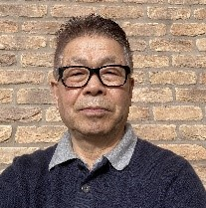
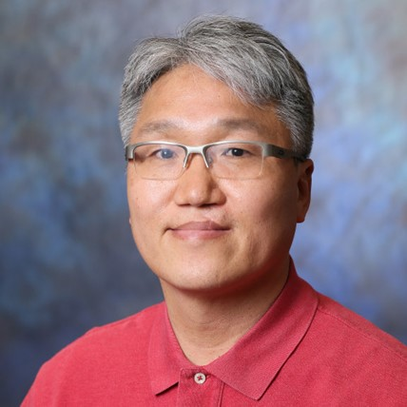


Brian Shin
Seong Choi

Slide 3
Power and Energy as
First-Class AI Design Metrics
Jae-Won Chung

Slide 4
How Silicon Valley and Energy
Companies Must Both Win
for AI to Scale
Jieul Jang

Slide 5
Challenges of Modern Power Grid Operations
Brian Shin

Slide 6
The Control Room of the Future:
AI Meets Digital Twin
Seong Choi

Slide 7
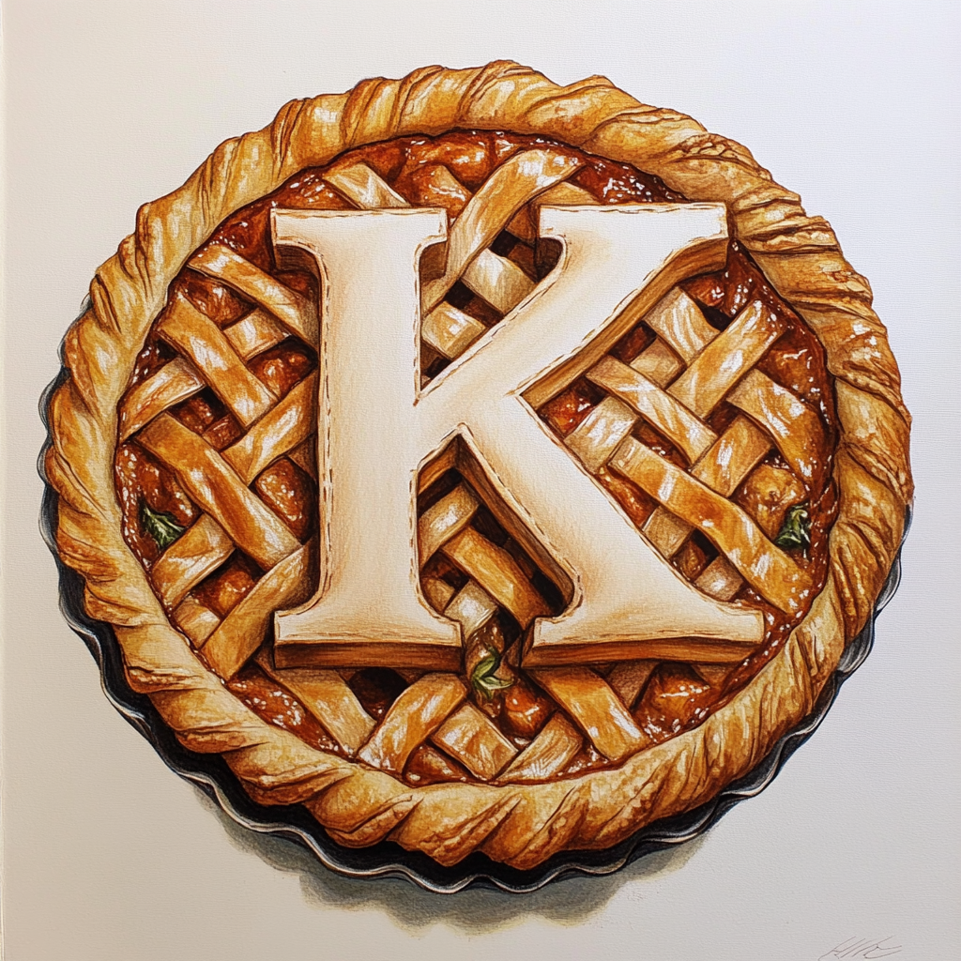
Power Paradigm
AI-Driven Solutions for Energy’s Future

